Slide 1
Security Analysis of Mattermost
By Changze Cui & Weihao Dong

Slide 2

What is Mattermost

Slide 3
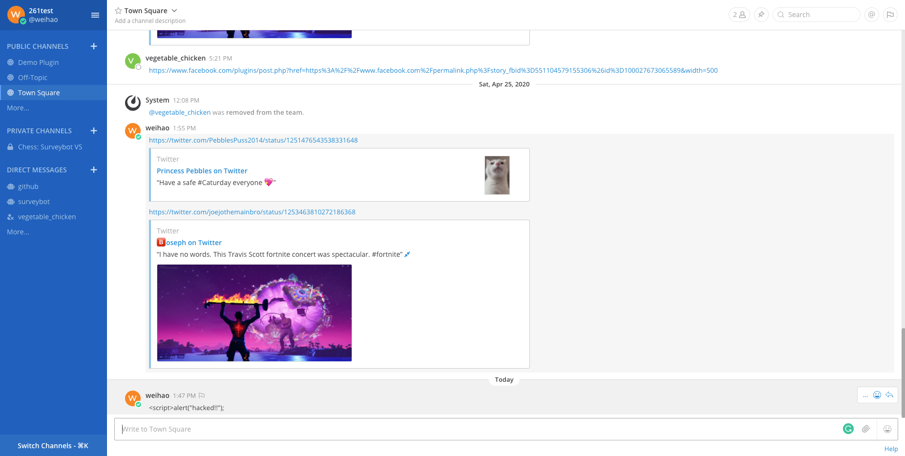
What is Mattermost

Slide 4
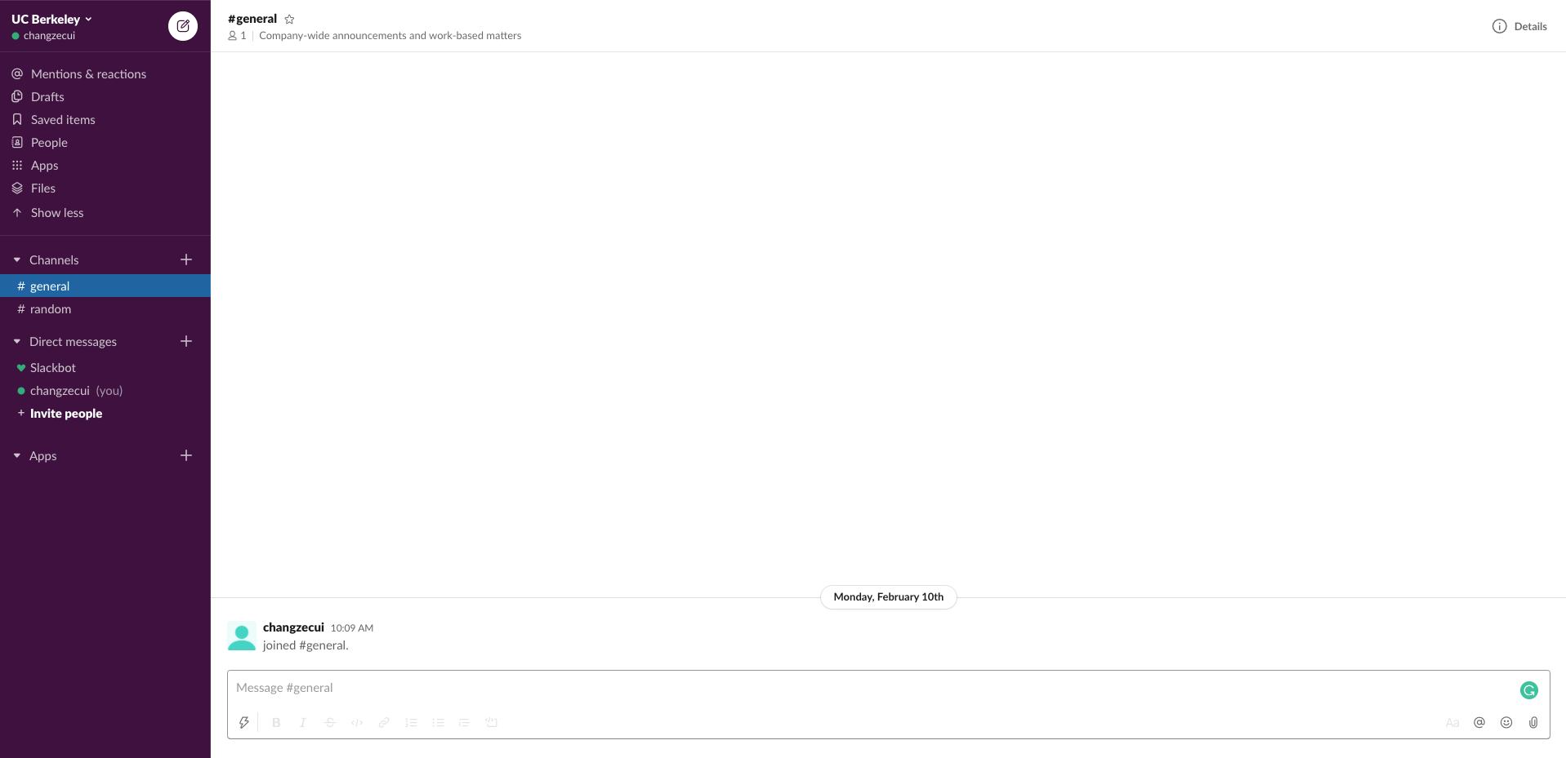
What is Mattermost

Slide 5


Key Difference between Mattermost and Slack
Support Self-Hosting | yes | no
Open Source | yes | no
Mattermost envisions itself as an open source Slack alternative

Slide 6
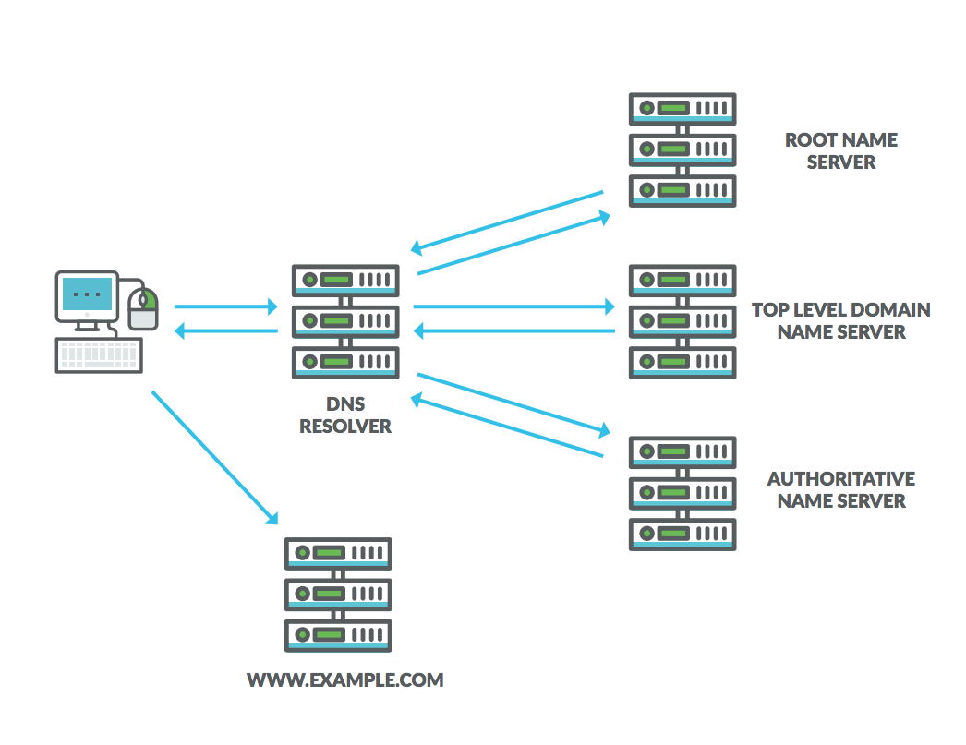
Light Directory Access Protocol/Active Directory
DNS is a directory service for the internet
https://www.appneta.com/blog/101-what-is-dns-and-why-is-it-important

Slide 7



Light Directory Access Protocol/Active Directory
LDAP is an application protocol for accessing and maintaining distributed directory information over network.
AD is a directory service developed by Microsoft based on LDAP
Service
LDAP Service
Service

Slide 8

Motivations

Slide 9
Project Timeline
Read Documentation
Extracted features
Acquired and deployed a trial of Enterprise Edition of Mattermost
Phase2
Phase4
Phase1
Phase3
Came up with
Threat Model
Conducted behavior analysis and source code analysis
Network Capture, Static Analysis, Manual Analysis, POC generation

Slide 10
Architecture of Mattermost
Mattermost Server
Notification Service
Internet
Proxy
Database
(MySQL, Postgres)
Email Service
HTTPS
Secure Web Sockets
File Store
(Amazon S3)
PC Web Experience
Mobile APP Experience
Mobile Web Experience
Email Client
https://docs.mattermost.com/deployment/deployment.html

Slide 11
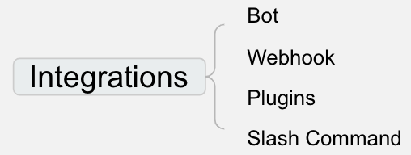
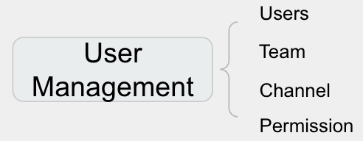
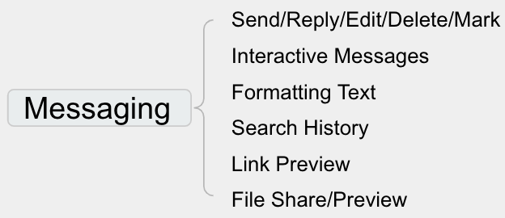
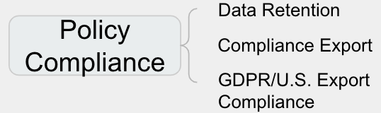
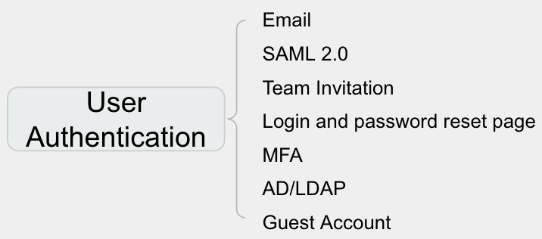
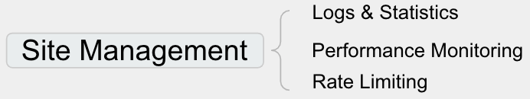
Features of Mattermost
Mattermost Server
Notification Service
Internet
Proxy
Database
(MySQL, Postgres)
Email Service
Password Hashing
HTTPS
Secure Web Sockets
Encryption-at-rest
Scalability Support
File Store
(Amazon S3)
PC Web Experience
Data Management
Mobile APP Experience
RESTful API
Mobile Web Experience
OAuth2.0
Email Client
https://docs.mattermost.com/deployment/deployment.html

Slide 12
Project Timeline
Read Documentation
Extract features
Acquired and deployed a trial of Enterprise Edition of Mattermost
Phase2
Phase4
Phase1
Phase3
Came up with
Threat Model
Conducted behavior analysis and source code analysis
Network Capture, Static Analysis, Manual Analysis, POC generation

Slide 13
How We Come Up With Our Threat Model
Mattermost Server
Notification Service
Internet
Proxy
Database
(MySQL, Postgres)
Email Service
Password Hashing
HTTPS
Secure Web Sockets
Encryption-at-rest
Scalability Support
File Store
(Amazon S3)
PC Web Experience
Data Management
Mobile APP Experience
RESTful API
Mobile Web Experience
OAuth2.0
Email Client
https://docs.mattermost.com/deployment/deployment.html

Slide 14
Attackers in Server & Database
Mattermost Server
Notification Service
Internet
Proxy
Database
(MySQL, Postgres)
Email Service
Password Hashing
HTTPS
Secure Web Sockets
Encryption-at-rest
Scalability Support
File Store
(Amazon S3)
PC Web Experience
Data Management
Mobile APP Experience
RESTful API
Mobile Web Experience
OAuth2.0
Email Client
https://docs.mattermost.com/deployment/deployment.html

Slide 15
Attackers as Non-Admin Mattermost Users
Mattermost Server
Notification Service
Internet
Proxy
Database
(MySQL, Postgres)
Email Service
Password Hashing
HTTPS
Secure Web Sockets
Encryption-at-rest
Scalability Support
File Store
(Amazon S3)
PC Web Experience
Data Management
Mobile APP Experience
RESTful API
Mobile Web Experience
OAuth2.0
Email Client
https://docs.mattermost.com/deployment/deployment.html

Slide 16
Attackers as Non-Users
Mattermost Server
Notification Service
Internet
Proxy
Database
(MySQL, Postgres)
Email Service
Password Hashing
HTTPS
Secure Web Sockets
Encryption-at-rest
Scalability Support
File Store
(Amazon S3)
PC Web Experience
Data Management
Mobile APP Experience
RESTful API
Mobile Web Experience
OAuth2.0
Email Client
https://docs.mattermost.com/deployment/deployment.html

Slide 17
Project Timeline
Read Documentation
Extract features
Acquired and deployed a trial of Enterprise Edition of Mattermost
Phase2
Phase4
Phase1
Phase3
Came up with
Threat Model
Conducted behavior analysis and source code analysis
Network Capture, Static Analysis, Manual Analysis, POC generation

Slide 18
Attackers in Server & Database
Mattermost Server
Notification Service
Internet
Proxy
Database
(MySQL, Postgres)
Email Service
Password Hashing
HTTPS
Secure Web Sockets
Encryption-at-rest
Scalability Support
File Store
(Amazon S3)
PC Web Experience
Data Management
Mobile APP Experience
RESTful API
Mobile Web Experience
OAuth2.0
Email Client
https://docs.mattermost.com/deployment/deployment.html

Slide 19
Attackers in Server & Database
Everything is readable. But is it the end of the nightmare?
Credential breach
Session token stealing
Integrated applications can be compromised

Slide 20
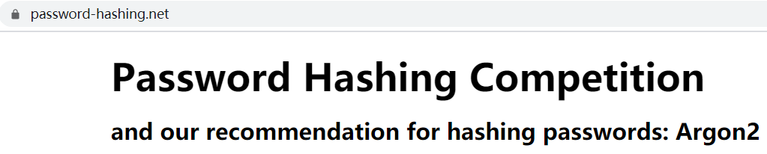
Attackers in Server & DB - Credential Breach
Password
Plain text passwords can be used for credential stuffing
Mattermost only stores bcrypt hashed passwords into database
bcrypt is probably not the best choice with the evolution of parallel hardware ¹
scrypt and argon2 ² provide better defense against offline parallel cracking
[1] Malvoni, Katja, and Josip Knezovic. “Are your passwords safe: Energy-efficient bcrypt cracking with low-cost parallel hardware.” 8th USENIXWorkshop on Offensive Technologies (WOOT 14). 2014.
[2] Biryukov, Alex, Daniel Dinu, and Dmitry Khovratovich. "Argon2: new generation of memory-hard functions for password hashing and other applications." 2016 IEEE European Symposium on Security and Privacy (EuroS&P). IEEE, 2016.

Slide 21
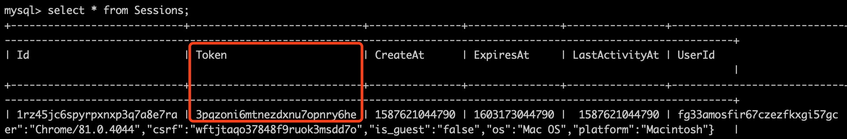
Attackers in Server & DB - Session Stealing
Session token generated by Google UUID (based on RFC 4122 and DCE 1.1: Authentication and Security Services)
Valid for 180 days
Stored in database as plain text
Can be stolen and used to impersonate any user

Slide 22
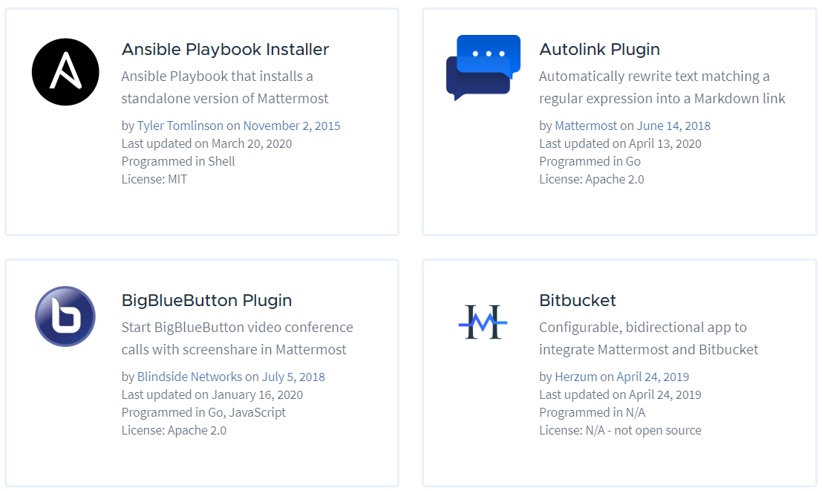
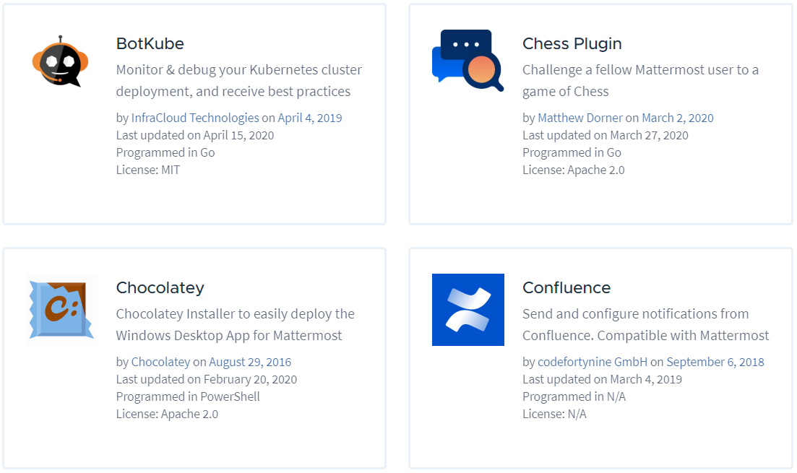
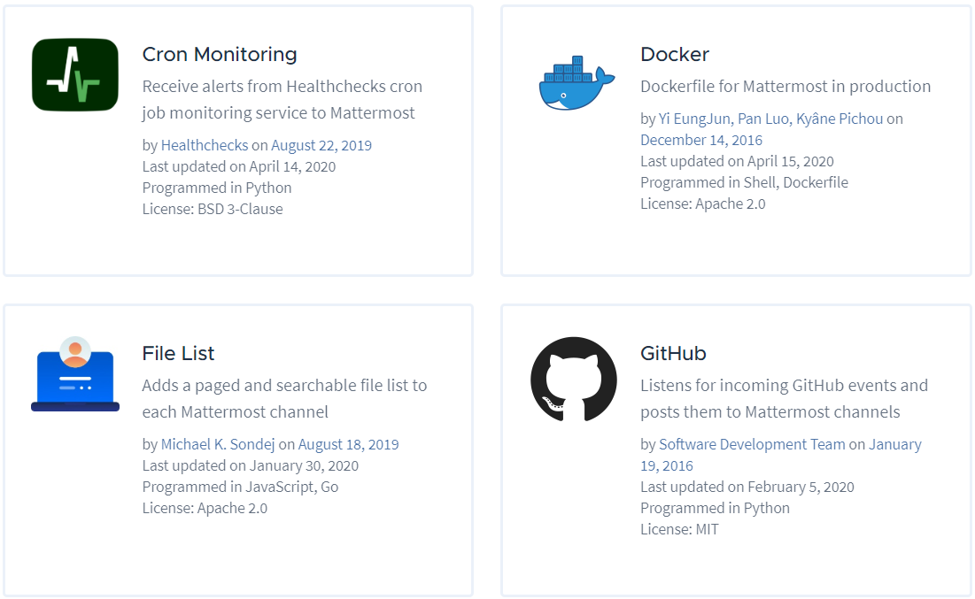
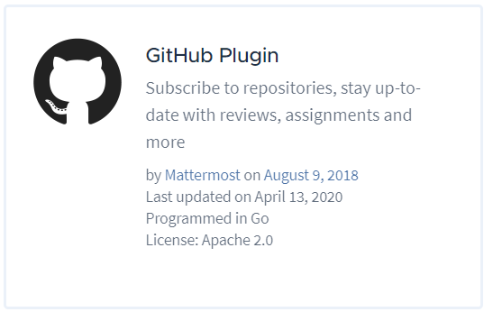
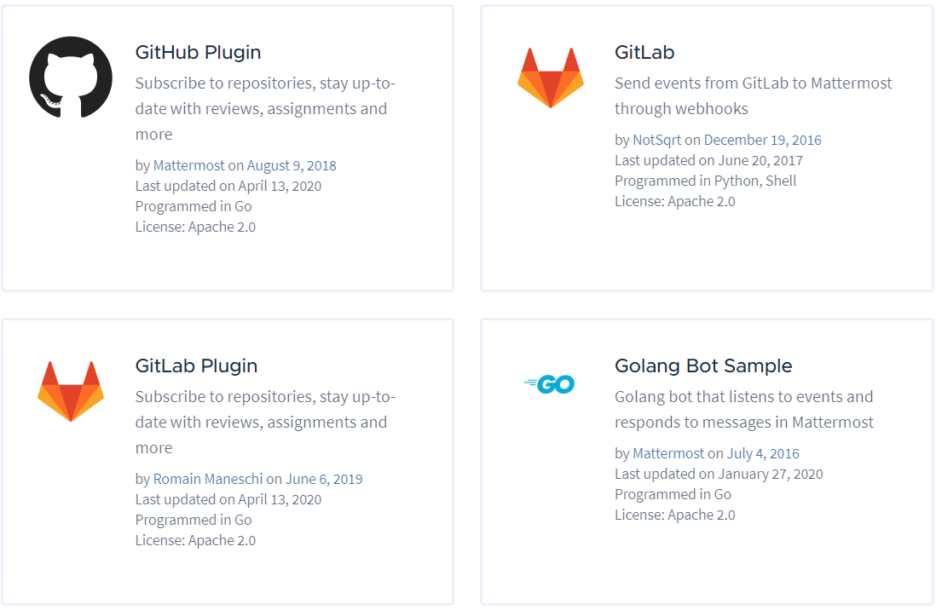
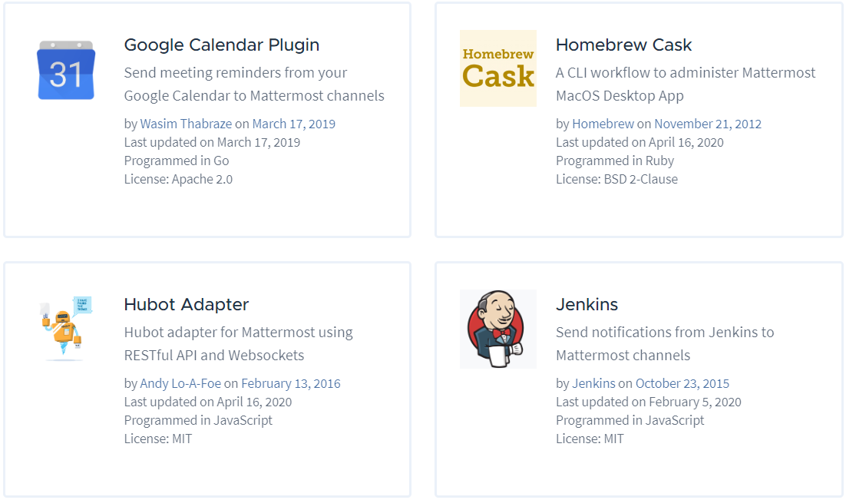
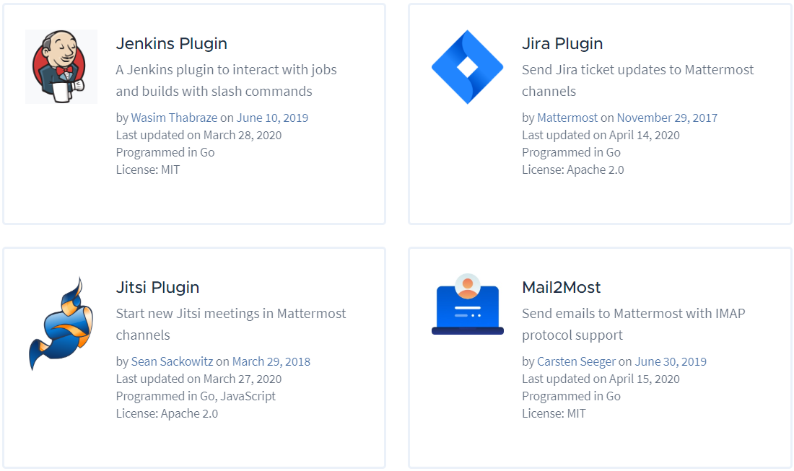
Attackers in Server & DB - Integrated Applications

Slide 23
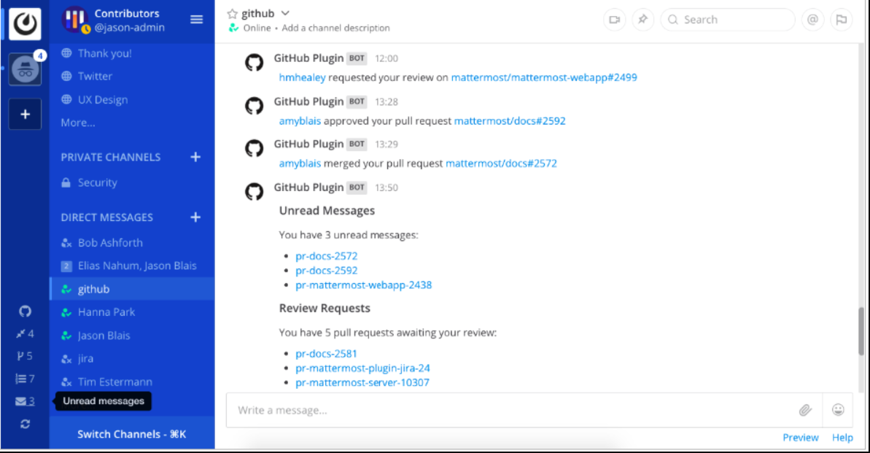
Attackers in Server & DB - Integrated Applications
Realtime notification
Show TODO list

Slide 24
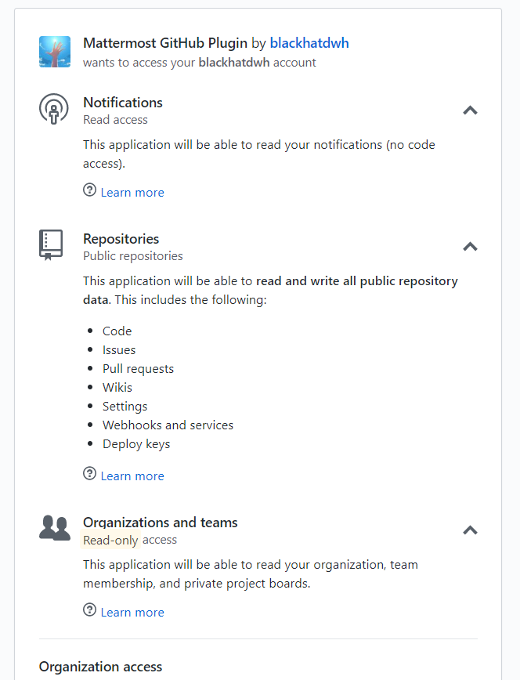
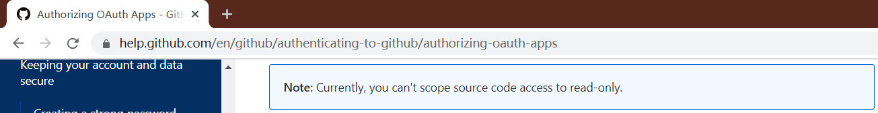
Attackers in Server & DB - Integrated Applications

Slide 25
Attackers in Server & DB - Integrated Applications
GitHub token is AES-256 encrypted and stored in database
Encryption key is randomly generated and stored in a json file
Still safe when the database is dumped, but not safe when fully compromised

Slide 26
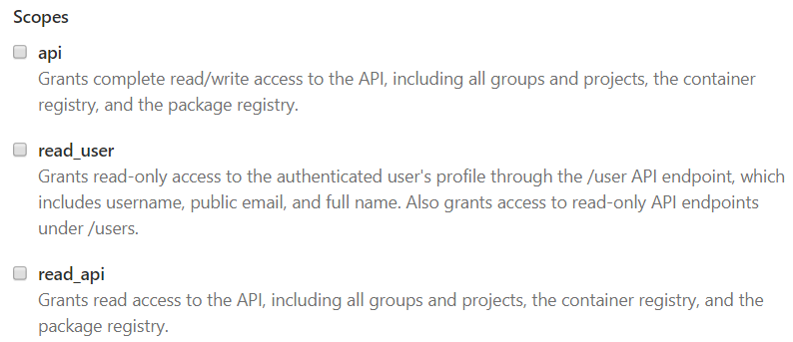

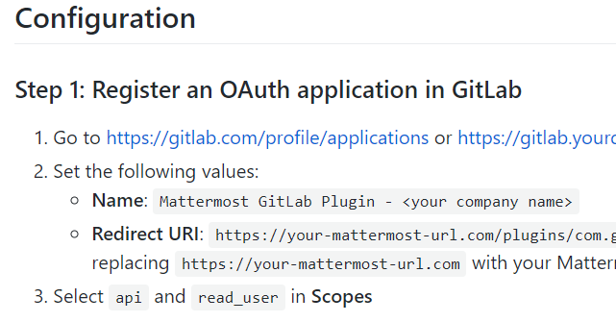
Attackers in Server & DB - Integrated Applications

Slide 27
Attackers as Root Users - Conclusion
Bcrypt as the password hashing function is becoming unsafe
Session token stored as plain text can lead to impersonate attack
Notification plugins can leak your intellectual property because of coarse grained permission control

Slide 28
Attackers as Non-Admin Mattermost Users
Mattermost Server
Notification Service
Internet
Proxy
Database
(MySQL, Postgres)
Email Service
Password Hashing
HTTPS
Secure Web Sockets
Encryption-at-rest
Scalability Support
File Store
(Amazon S3)
PC Web Experience
Data Management
Mobile APP Experience
RESTful API
Mobile Web Experience
OAuth2.0
Email Client
https://docs.mattermost.com/deployment/deployment.html

Slide 29
Attackers as Non-Admin Mattermost Users
A solid step. But what’s next?
Target
Intellectual property and trade secret (Posts), as the threat model suggests
Approach
Become Mattermost’s system admin (XSS attack, password cracking, SQL injection etc.)
Trick other users (Phishing)
Dump the database (SQL injection)

Slide 30



Attackers as Non-Admin Users - XSS attack
Session token is stored in cookies
Steal token by XSS attack - document.cookie;
RESTful API of role management
Send <script>XMLHttpRequest.open()</script> to the admin
Send [click me](JavAsCripT:alert();) to the admin
[click me](javascript:alert();)
Token is set to be httponly
<a href=javascript:alert();>click me</a>
<> will be escaped to &gt; &lt;
URL will be checked before rendered

Slide 31
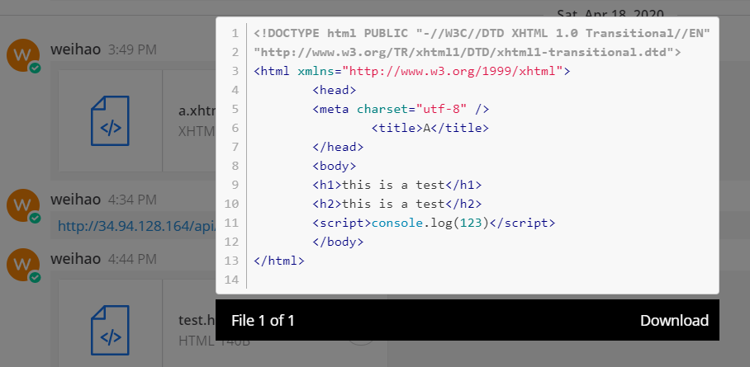
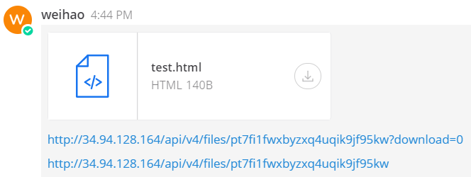
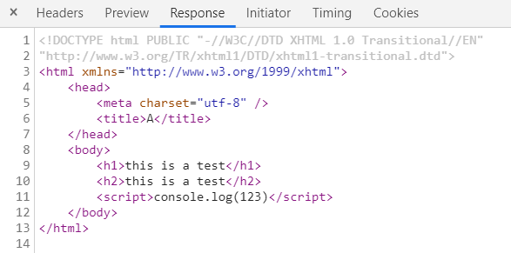
Attackers as Non-Admin Users - XSS attack
Backend sends unescaped text file to user for file preview
Upload a malicious HTML file and trick the admin to preview it
File preview won’t be triggered for a link to the file
Bypass the frontend escape by posting a link to the HTML file
Frontend escapes it
Content-Disposition in the header is set to attachment

Slide 32
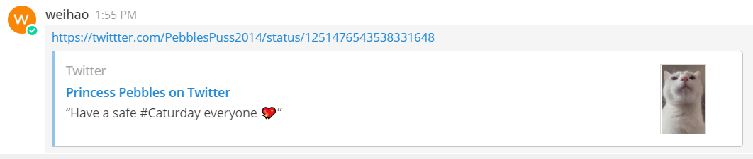



Attackers as Non-Admin Users - Phishing
1. Post a link
2. Send a GET request
3. Return full content
4. Summarize the content and display
User-Agent: Mattermost 5.22

Slide 33

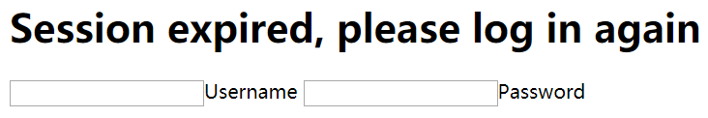
Attackers as Non-Admin Users - Phishing
twittter.com
User-Agent: Mattermost 5.22
Aha! It’s Mattermost making link preview
Aha! It’s a normal user, gonna trick him
Cute cat
User-Agent: Chrome/81.0.4044
Session Expire, Please log in

Slide 34
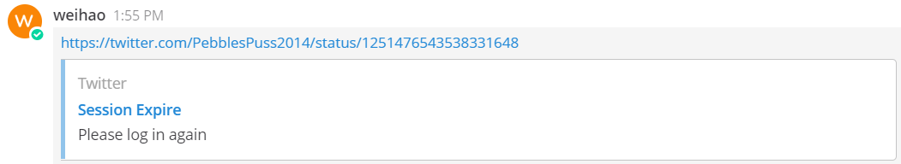
Attackers as Non-Admin Users - Phishing
No link preview
Honest link preview
Fake link preview

Slide 35
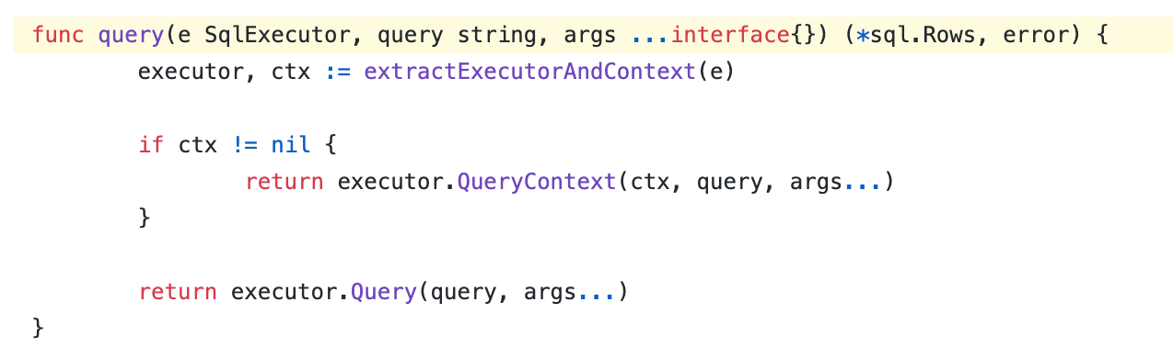
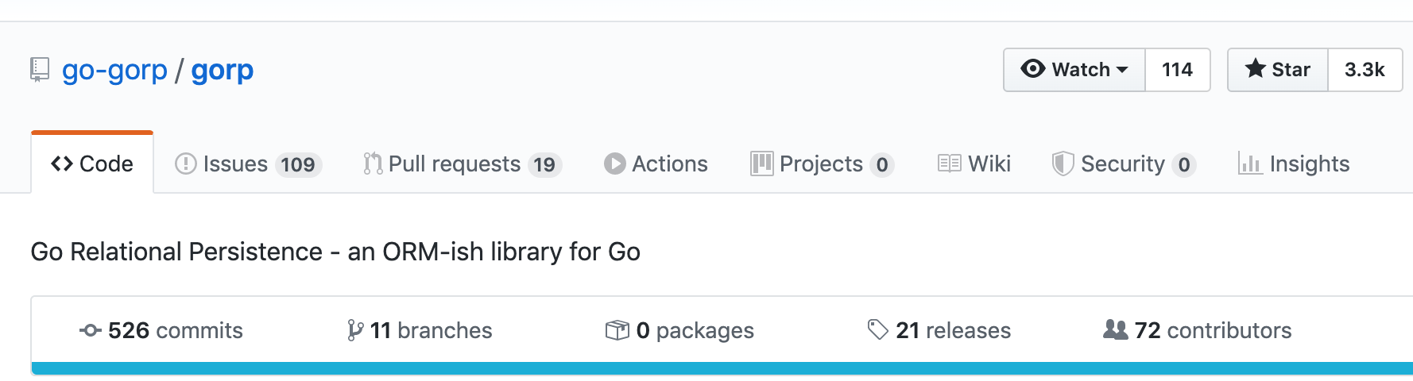
Attackers as Non-Admin Users - SQL Injection

Slide 36
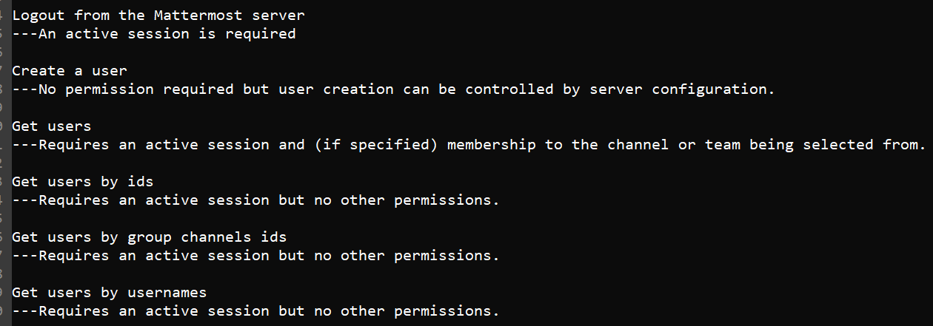
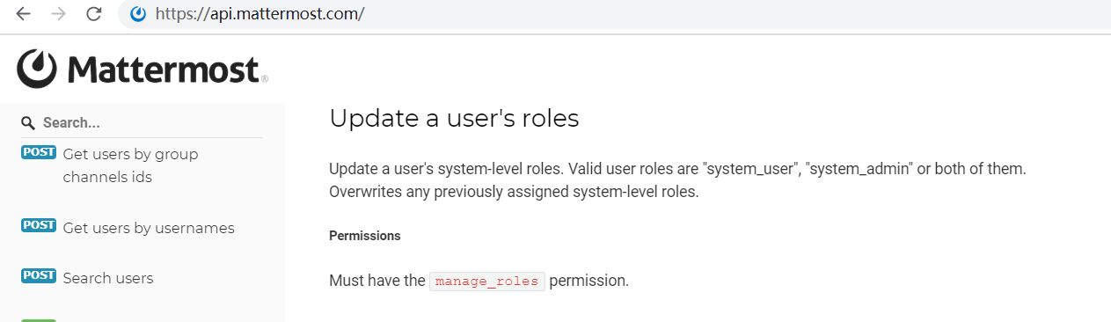
Attackers as Non-Admin Users - API Permission
Mattermost has 313 APIs and 50 permissions
Could there be any vulnerability for privilege escalation?
Wrote a crawler to collect APIs and corresponding permission requirements

Slide 37
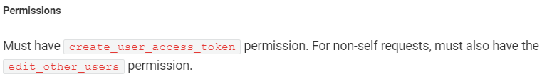


Attackers as Non-Admin Users - API Permission
Permissions are written in natural language, hard to process

Slide 38
Attackers as Non-Admin Users - API Permission
You need permission #M to call API #N
You need permission #M and valid password to call API #N
Calling API #X grants you permission #Y
Permission #M
Permission #M
API #X
Permission #Y
API #N
API #N

Slide 39
Attackers as Non-Admin Users - API Permission

Slide 40
Attackers as Non-Admin Users - Conclusion
We failed to launch an XSS attack
SQL injection is unlikely to be launched
Link preview can trick you

Slide 41
Attackers as Non-Users
Mattermost Server
Notification Service
Internet
Proxy
Database
(MySQL, Postgres)
Email Service
Password Hashing
HTTPS
Secure Web Sockets
Encryption-at-rest
Scalability Support
File Store
(Amazon S3)
PC Web Experience
Data Management
Mobile APP Experience
RESTful API
Mobile Web Experience
OAuth2.0
Email Client
https://docs.mattermost.com/deployment/deployment.html

Slide 42
Attackers as Non-Users - User Onboard
Email
SAML
Team Invitation

Slide 43
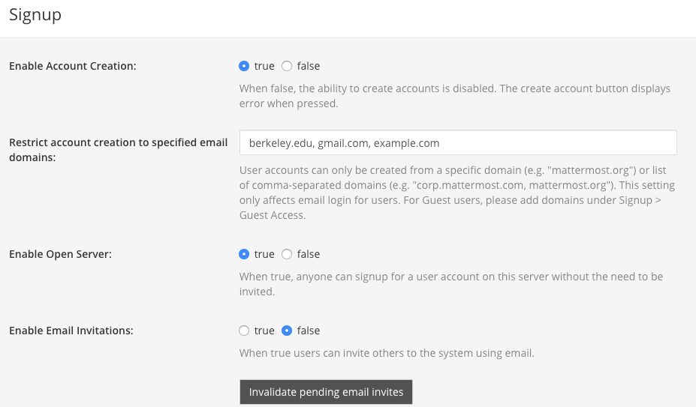
User Onboard - Email-based Registration
walk through these features, if implemented correctly, there's no issue

Slide 44
User Onboard - SAML-based Registration
A XML-based protocol for exchanging identities between Identity Provider and Service Provider
Used for Authentication
Commonly used in Single-sign On application
Fundamentally different from OAuth 2.0
https://www.ubisecure.com/uncategorized/difference-between-saml-and-oauth/

Slide 45
How SAML 2.0 Works
Service Provider
User
Identity Provider
Exchange certificate
access service
1
Generate and sign the auth
request
3
2
Redirect user to identity provider along with the auth request
Verify auth request and
4
User logs in
5
7
User logs in the service
Redirect user to service provider along with auth response
Generate auth response
8
6

Slide 46
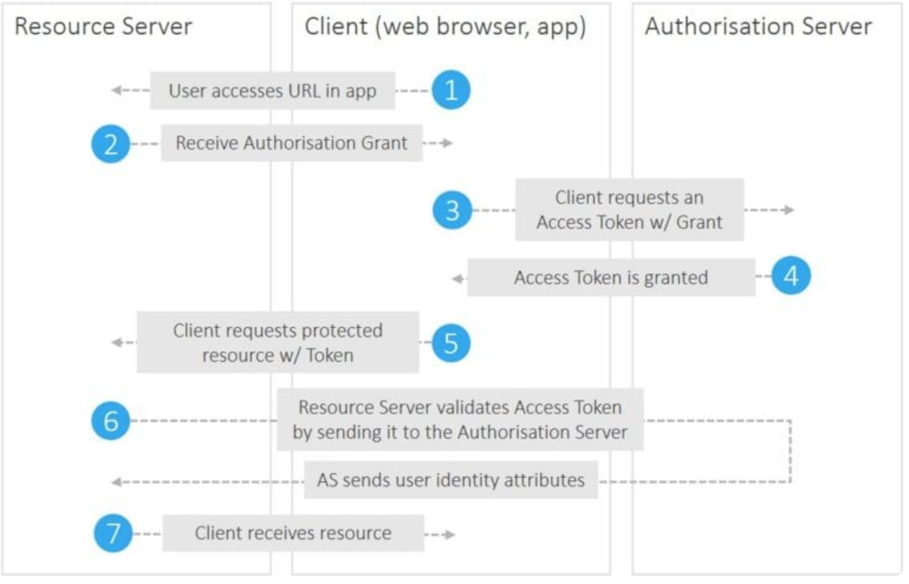
OAuth 2.0 Flow
https://www.ubisecure.com/uncategorized/difference-between-saml-and-oauth/
A XML-based protocol for exchanging authorization identities between identity provider and service provider. It’s commonly used in SSO application

Slide 47
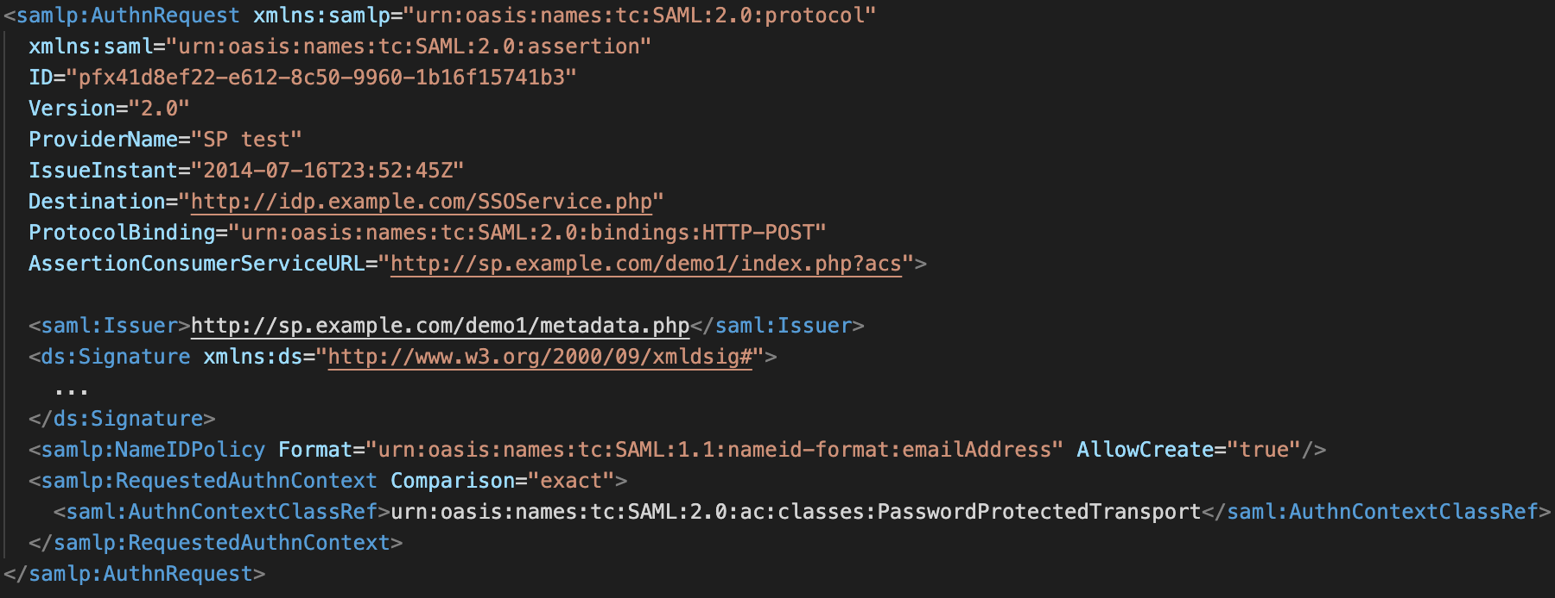
SAML 2.0 - Sample Auth Request
https://developers.onelogin.com/saml/examples/authnrequest

Slide 48
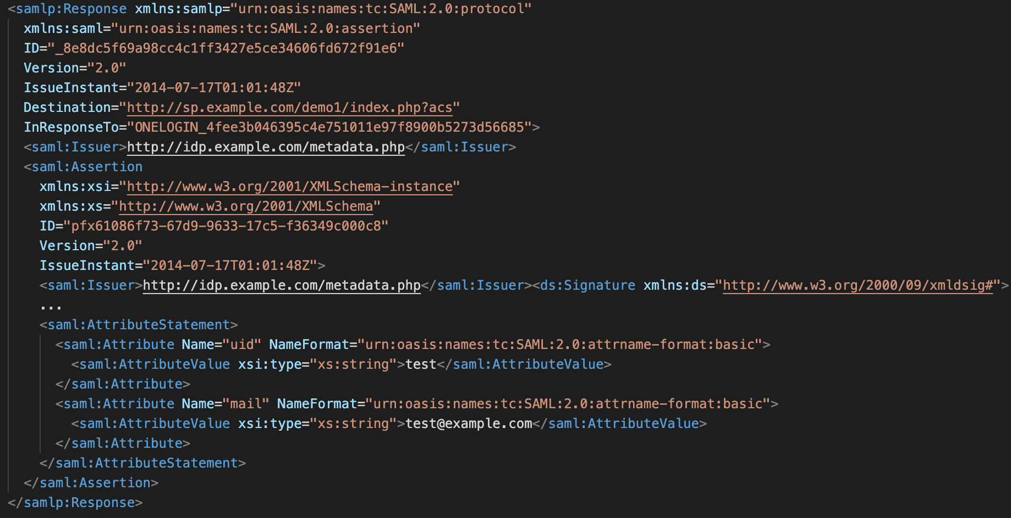
SAML 2.0 - Sample Auth Response
https://developers.onelogin.com/saml/examples/response

Slide 49
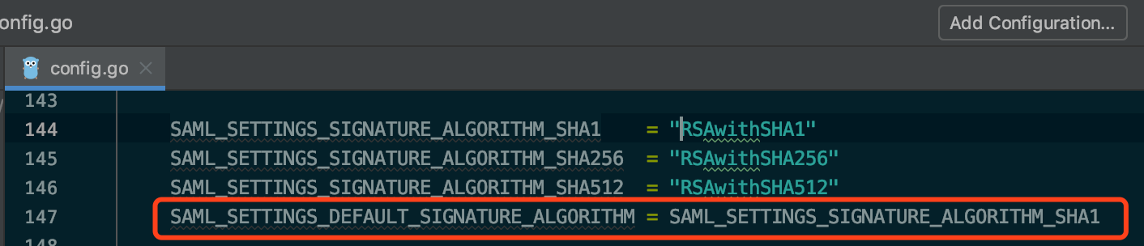
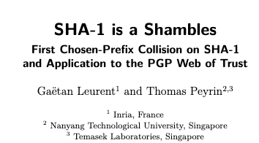
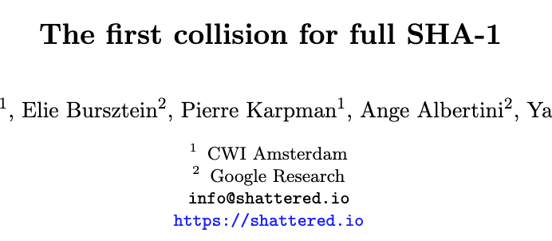
SAML Signature Algorithm is not Safe

Slide 50

If attackers could forge the Signature
1) visit
4) Sign the fake Auth Response
Mattermost
2) Auth request
Hard
but possible
3) Eavesdropping
Identity Provider
animation, mention it is still hard today, or this is national supported hacker which can afford

Slide 51
User Onboard - Team Invitation

Slide 52
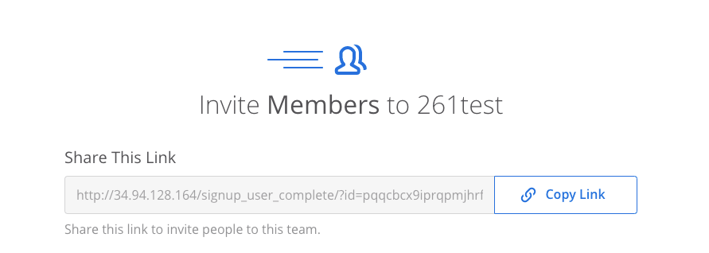
User Onboard - Team Invitation
http just for test
讲一下private team的事情

Slide 53
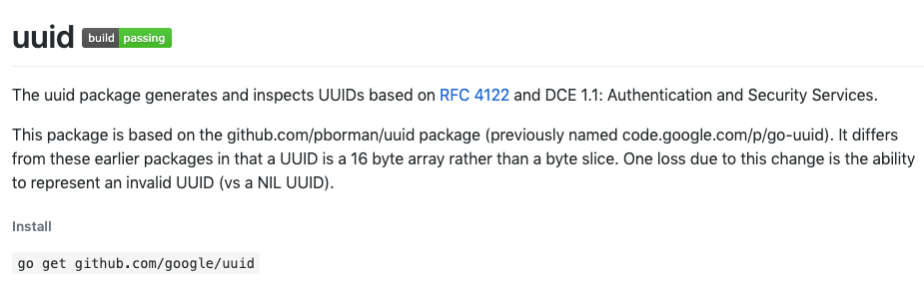
Attackers as Non-Users - Team Invitation
讲一下private team的事情

Slide 54
Attackers as Non-Users - Team Invitation
讲一下private team的事情

Slide 55
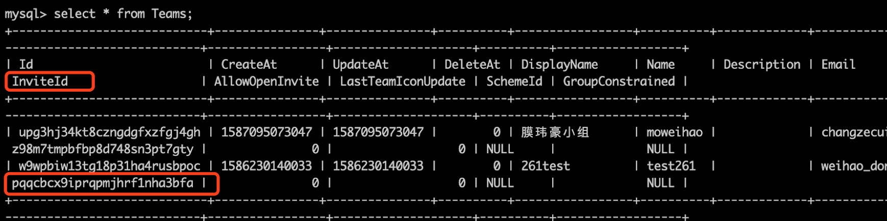
Attackers as Non-Users - Team Invitation
Invitation id 默认不变
每个人的invitation id都一样，找不到leakage source

Slide 56
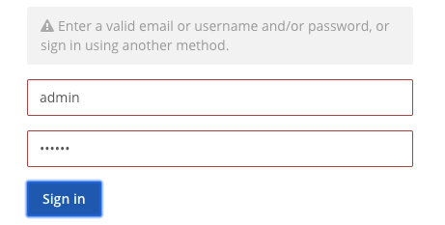
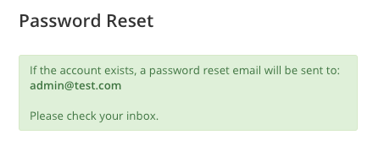
Attackers as Non-Users - Login

Slide 57
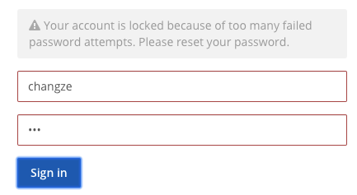
Attackers as Non-Users - Login

Slide 58
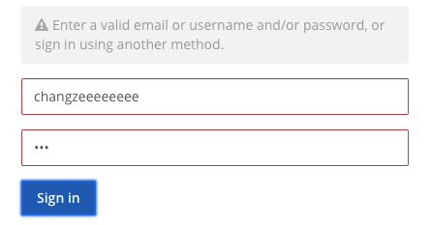
Attackers as Non-Users - Login

Slide 59
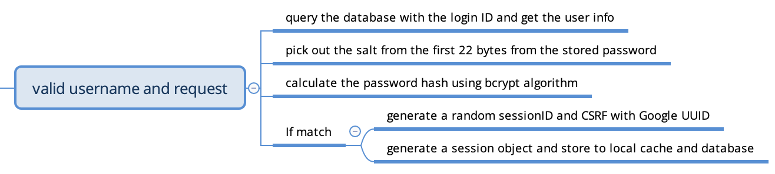
Attackers as Non-Users - Login

Slide 60
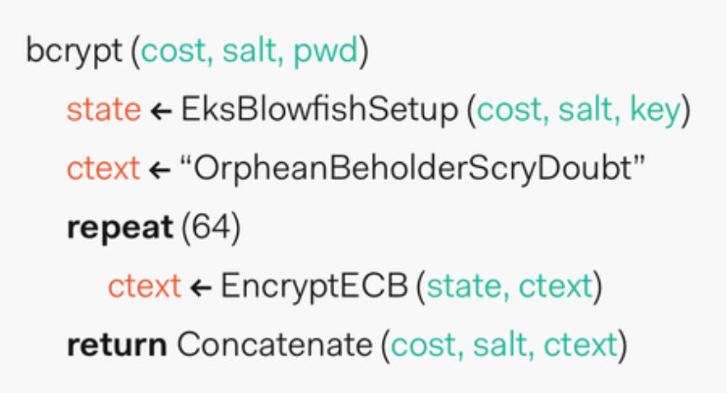
Bcrypt Algorithm
Designed in 1999 by Niels Provos and David Mazieres
A commonly used password hashing algorithm

Slide 61

Attackers as Non-Users - Session

Slide 62

Attackers as Non-Users - Phishing with webhook
Exposed URL
Application A
Application B

Slide 63


Attackers as Non-Users - Phishing with webhook
1. Create an incoming webhook
3. Send a request to the secret link when a trading curb is triggered
admin
2. Returns a secret link
6. Steal admin’s account
4. HTTP POST: {“text”: “alarm!”}
8. Post “phishing!” to a channel
7. HTTP POST: {“text”: “phishing!”}
5. Post “alarm!” to a channel

Slide 64




Attackers as Non-Users - Phishing with webhook
A BOT tag is attached to messages posted by webhook
Changze is our new team leader now, please add changze@evil.com to the github repo.
Allows username and icon override

Slide 65
Attackers in Supply Chain Vulnerabilities
Mattermost Server
Notification Service
Internet
Proxy
Database
(MySQL, Postgres)
Email Service
Password Hashing
HTTPS
Secure Web Sockets
Encryption-at-rest
Scalability Support
File Store
(Amazon S3)
PC Web Experience
Data Management
Mobile APP Experience
RESTful API
Mobile Web Experience
OAuth2.0
Email Client
https://docs.mattermost.com/deployment/deployment.html

Slide 66




















Attackers in Supply Chain Vulnerabilities
49 personal projects
Mattermost Server
271 open source projects in total

Slide 67


Attackers in Supply Chain Vulnerabilities

Slide 68

Attackers Aiming at Plugins
Allows installing plugin binaries from untrusted third party
No permission control for plugins
Plugins have the same permission as Mattermost itself

Slide 69
Future Work Beyond Our Project
A closer look at Mattermost
  Notification system
  Client side software
  Upgrading
  License Management
Apply our investigation method to similar applications (e.g., Slack)

Slide 70
Thanks

Slide 71
Send/Reply/Edit/Delete/Mark
Users
Interactive Messages
User Management
Team
Messaging
Formatting Text
Search History
Channel
Link Preview
Permission
File Share/Preview
Bot
Integrations
Webhook
Plugins
Slash Command

Slide 72
Data Retention
Policy Compliance
Compliance Export
Email
GDPR/U.S. Export Compliance
SAML 2.0
User Authentication
Team Invitation
Login and password reset page
MFA
AD/LDAP
Guest Account
Logs & Statistics
Site Management
Performance Monitoring
Rate Limiting

